Slide 1
LCD
Julio César Almada Fuerte
A00226046
ITE

Slide 2
The DE10 board includes a LCD part that is connected to the 128 x 64 pixel display.
Data is written to the LCD in pages which consist of 128 x 8 pixel section of the display for a total of 8 pages.
Each column of a page is presented as a byte, where each bit corresponds to one pixel in that column.
To write to the display, the page address is written to the data register of SPIM0 followed by the column address, then the corresponding 8 bits of pixel data may be written. After that the column address is incremented automaticcally.

Slide 3
Before writing to the display, the SPIM0 and the LCD need to be initialized.
Finally the LCD registers must be initialized.
Create a program on which:
Key0: Displays the alphabet
Key1: Display the alphabet in ascending order, each time you press this button.
Key2: Display the alphabet in descending order, each time you press this button.
Key3:Display a personal message

Slide 4
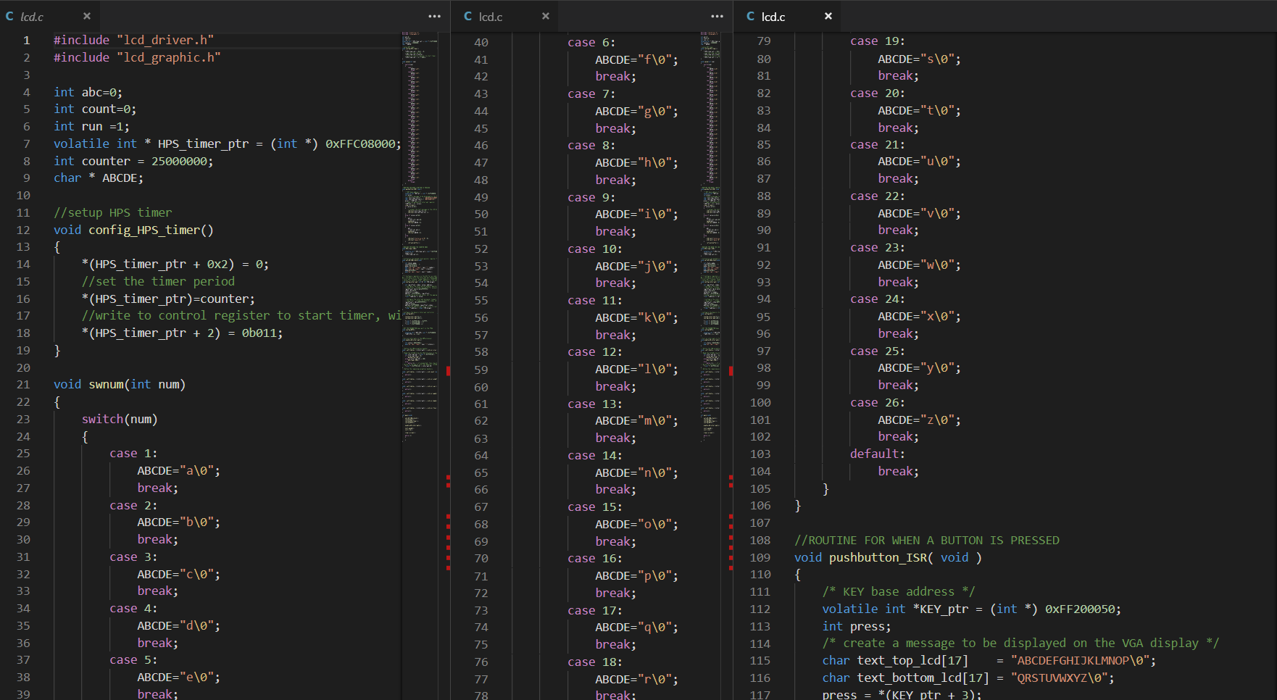

Slide 5
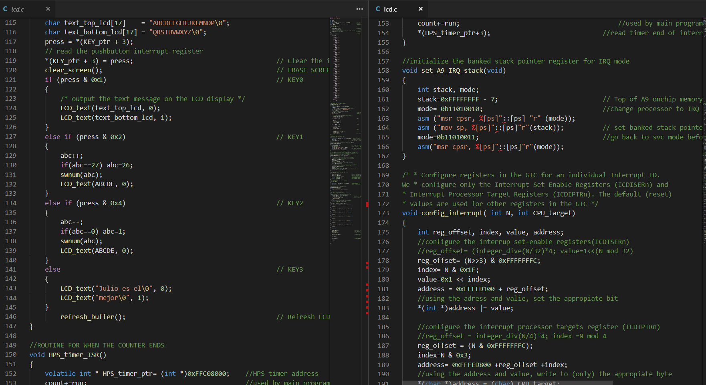

Slide 6
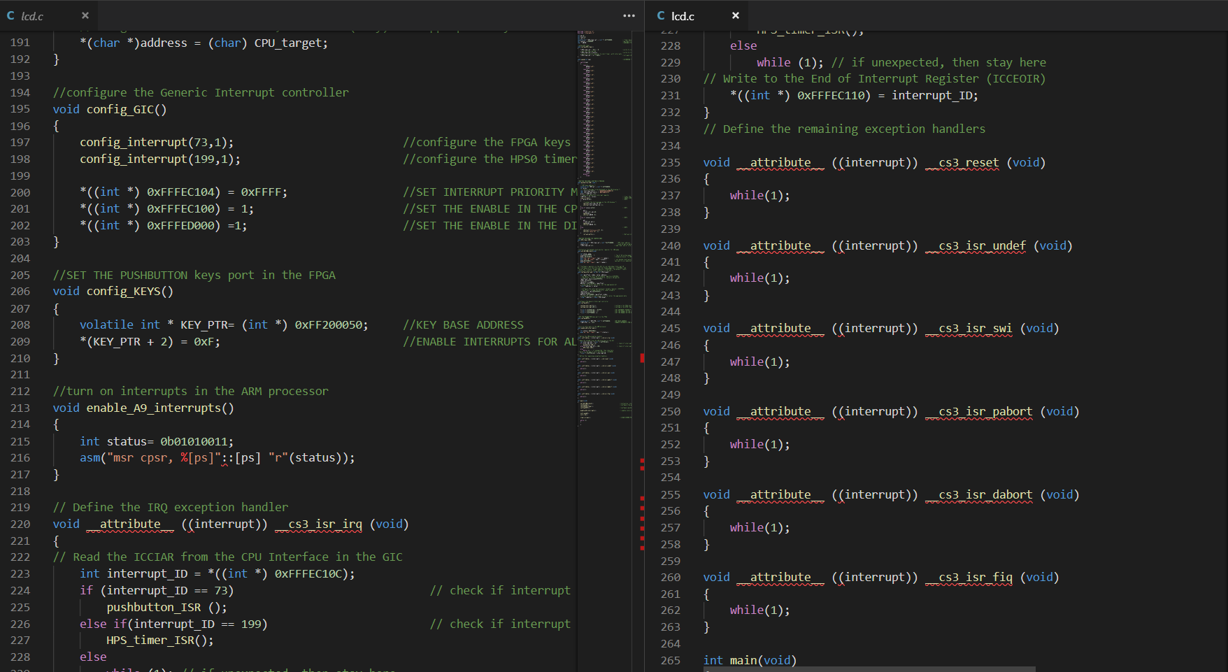

Slide 7
